Slide 1

Getting Credit for Your Memberships:
How to Properly Transmit Membership to Detachment
Sons of The American Legion
Detachment of Texas
http://saltexas.org

Slide 2
Preamble
Proud possessors of a priceless heritage, we male descendants of veterans of the Great Wars, associate ourselves together as "Sons of The American Legion" for the following purposes:
To uphold and defend the Constitution of the United States of America; to maintain law and order; to foster and perpetuate a true spirit of Americanism; to preserve the memories of our former members and the associations of our members and our forefathers in the Great Wars; to inculcate a sense of individual obligation to the community, state and nation; to combat the autocracy of both the classes and masses; to make right the master of might; to promote peace and good will on earth; to safeguard and transmit to posterity the principles of justice, freedom and democracy; to consecrate and sanctify our friendship by our devotion to mutual helpfulness; to adopt in letter and spirit all of the great principles for which The American Legion stands; and to assist in carrying on for God and Country.

Slide 3
Introduction
This training is designed for use by the Squadron Adjutant, Squadron Vice Commander or Membership Chairman.
It is primarily designed for those members who will be taking care of membership and membership related records.
Regardless of whether you are an “old hand” at membership and this is a refresher or new to the job, we hope you keep this power point and /or training as a reference.

Slide 4
Membership Resources
Your Post Adjutant of your Post Home
Your District Commander, District Vice Commander or District Membership Director
Your Detachment Commander, Vice Commander or Membership Director
The Department of Texas Office at 512-472-4138
Richard Bartholomew, SAL Detachment Membership Chairman at 800-771-6945; bkuehner@sbcglobal.net

Slide 5
Eligibility
All male descendants, adopted sons and stepsons of members of The American Legion, and such male descendants of veterans who died in Service during World I, World War II, the Korean War, the Vietnam War, Lebanon, Grenada, Panama, the Persian Gulf War and the War on Terrorism, during the delimiting periods set forth in Article IV, Section 1, of the National Constitution of The American Legion, or who died subsequent to their honorable discharge from such service, shall be eligible for Membership in the Sons of The American Legion.

Slide 6
Eligibility Break Down
Qualifying Relative
Applicable Service Dates:
Membership is open to:
All male descendants – sons, adopted sons, stepsons, grandsons, great grandsons, etc. - of members of The American Legion; and
All male descendants of deceased Veterans who would be eligible for membership in The American Legion if the Veteran were alive.
If a qualifying relative served in federal active duty in the United States Armed Forces during any of the war eras listed below, AND was honorably discharged or is still serving – you are eligible for membership in The Sons of The American Legion:
April 6, 1917 to November 11, 1918
December 7, 1941 to December 31, 1946
June 25, 1950 to January 31, 1955
February 28, 1961 to May 7, 1975
August 24, 1982 to July 31, 1984
December 20, 1989 to January 31, 1990
August 2, 1990 to today

Slide 7
Eligibility Checklist
Does the potential members have a qualifying relative who is or was eligible for membership in The American Legion?
Is the qualifying relative alive?
  If no, the potential member is eligible to join and a membership card should be issued upon paying any applicable dues.
  If yes, then check to see if the qualifying relative is a member of The American Legion.
    If the qualifying relative is a member of The American Legion, the potential member is eligible to join and a membership card should be issued upon paying any applicable dues. Once a member, the member continues in good standing as long as his dues remain current even if the qualifying relative were to fail to renew their dues. If, however, the SAL member were to fail to timely renew, their eligibility would lapse.
    If the qualifying relative is not a member of The American Legion, the potential member is not eligible to join unless there is another qualifying relative or this qualifying relative joins The American Legion.
      Feel free to recruit a new member for your Post and get a new member for your Squadron!
Any questions on eligibility should be resolved by your Post Adjutant.

Slide 8
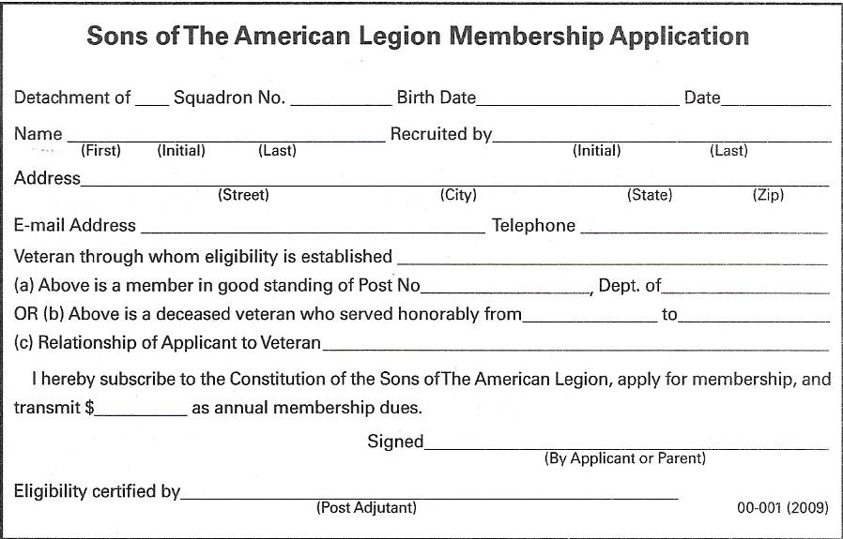
The Membership Application
The Application needs to establish the Name, Address, Telephone Number for the Membership Card.
It should also include the basis for eligibility for records – name of veteran, veteran’s dates of service, Post membership, if applicable.
Will you communicate by email, text? If so, ask for this information as well.

Slide 9
The Membership Record Card
The information on the Application allows you to complete the Membership Record Card:
  Name, Address, Phone Number, Date Paid, Initial
  Check “Renewal” “New” or “Transfer” (and only one!)
  If also a member of The American Legion, check on the Detachment Card portion
Do not separate the left and middle portions of the Membership Record!
Do not photocopy and submit, each card has a unique bar code!

Slide 10
Processing Memberships
Existing Members with a Preprinted Membership Card
New Members and Existing Members without a Preprinted Card
Verify their correct name and current address against Squadron records
Should have a pre-printed card – if so, check “renewal” box, fill in date paid and initial
Sign Membership Card (the right portion), detach and deliver to your member
If an address or name change is needed, complete a Member Data Form to update address change or change in MySAL.org
Update your Squadron (and Post) records, including date paid on your membership register
Verify eligibility
Print or type the name, address and telephone number information on the Membership Record card including member ID number if known (both left and middle sections)
Check the “new” box for new members, “renewal” for a renewing member w/o a preprinted card, fill in the date of approval / renewal and initial
Sign Membership Card (the right portion), detach and deliver to your new member
Update your Squadron (and Post) records to include your new member, including the date paid, member name and address on your membership register

Slide 11
Member Transfers
The Transfer Process
Transferring from one squadron to another is a privilege granted only to paid-up members.
The member requesting the transfer must have a membership card showing he is a member in good standing for the year in which transfer is made.
Must be paid in the current calendar year by February 1st.
The receiving squadron is free to seek documentation supporting eligibility.
The receiving squadron must fill out the appropriate section of the Member Data Form
The receiving squadron should issue a new card from its supply of blank cards, entering the 9-digit membership number listed on the transferring members former membership card.
List the 9-digit number in the “Member Id No.” section on the left and middle portion of the Membership Record card along with the member’s name and address.
Check the “Transfer” box , date and initial.
Sign and date the Member Data Form and have the transferee sign the Data Form to request the Transfer.
Sign the Membership Card (right portion) and give to your new member.
Submit the Data Form and Membership Record to the Detachment Office with a Transmittal Form (include as a “Renewal / Transfer” and in your total cards submitted)

Slide 12
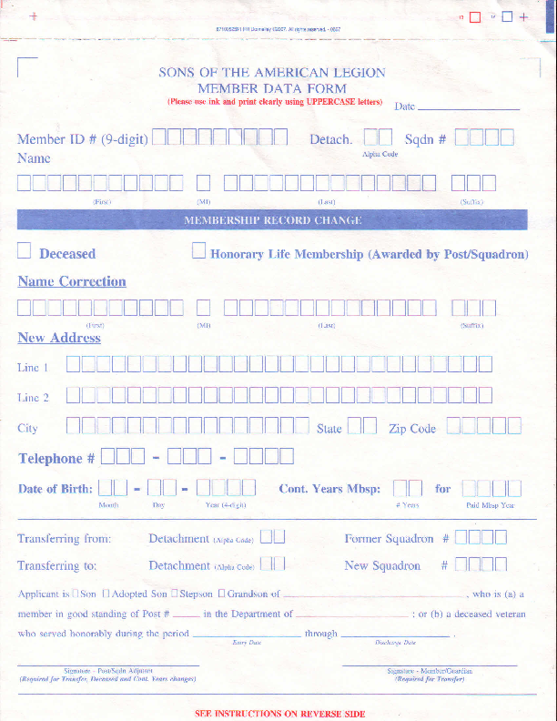
Member Data Form
The Member Data Form is used to report:
  Change of Name Spelling
  Change of Address
  Change in Continuous Years
  Transfers
  Reporting deceased members

Slide 13
MySAL.org
Provides online access to your squadron’s membership database as maintained by the National Office.
Allows next day updating of membership records.
Requires approval of the Post adjutant and submission of a password request.
Must be renewed annually.
MySAL.org can be used
  To update names, address, continuous years of service
  Reporting deceased members
  Creating mailing labels
  Verifying good standing / payments / processing
  CANNOT be used for transfers

Slide 14
Special Situations
Replacement / Lost Cards
Duplicate Cards
If you need to issue a replacement card, create a membership record card from your supply of blank cards.
Include the 9-digit ID number, name and address as if a renewing member without a pre-printed card
In pencil, write “replacement” across the face of the member record
Sign the Membership Card, including the member name and member ID number on the Membership Card
A duplicate card is more than one preprinted card for any one member.
Most likely to happen in the year following a renewing member without a preprinted card.
On the duplicate card, place an “X” in the box opposite the word “duplicate” on the Membership Record.
Return the entire card (left, middle and right portions) to Detachment Headquarters.
Remember “Duplicate” mean “delete”

Slide 15
Special Situations
Deceased Members
Error Correcting
If you have a preprinted Record Card for a member who is deceased, place an “X” in the box opposite the word “deceased” and return the entire (left, middle and right portions) card to Detachment Headquarters.
If a member passes away after his dues are paid and transmitted:
  Use a Member Data Form to Report the member’s passing, or
  Use MySAL.org to update the Member Record online
If you receive a card for someone who is not a member of your squadron, write “unknown” on the Membership Record and return the entire card (all 3 sections) to Detachment.
You can update a member’s name and continuous years on the Membership Record card by checking the “Cont. Yrs. Or Name Chg.” box and very legibly writing the corrected information on all portions of the Membership Record.

Slide 16
Transmittals
Think of the Membership Transmittal Form as a instruction sheet for Detachment. You are telling them what to do with your Membership Records for that year – renew, transfer, create a new record.
If there is no instruction sheet, i.e. Transmittal Form, Detachment doesn’t know what to do with what you sent them.
Enclose the Membership Record Cards (both the left and middle portions and not separated) for all of your renewals, transfers and new members.

Slide 17
Transmittals
List your Squadron #, Name and District so Detachment knows which Squadron is submitting and that your Squadron should receive the credit for the transmittal.
List the total number of Membership Records (left and middle portions) under total # of members so Detachment knows how many cards it should process as active members.
Separately list the total number of renewals / transfers and new members so Detachment specifically knows what to do with your cards.

Slide 18
Transmittals
Double check the number of cards you are submitting for processing and do the math. Its like carpentry, count twice, cut one check. If the check and cards don’t match, Detachment can’t tell what you’re trying to accomplish.
If you are using a credit at Department to pay a portion of your transmittal, write credit and the amount of credit you are asking to apply on the transmittal so Department knows why the check does not match the number of cards!
Mail to the address on the transmittal form and that address only!

Slide 19
Common Errors to Avoid
Separating the two left portions of the Membership Card – Keep Them Intact!!
Sending separate year’s membership cards on one transmittal form or with one check
  Treat each year’s transmittals as entirely separate!
Sending Membership Cards with out a completed transmittal form or check –
  Department needs to know what to do with what you are sending them – the transmittal form is their guide!
Double check your math!
  Correct number of cards? Correct amount on your check?
Explain your math. If you are using a credit, list it!

Slide 20
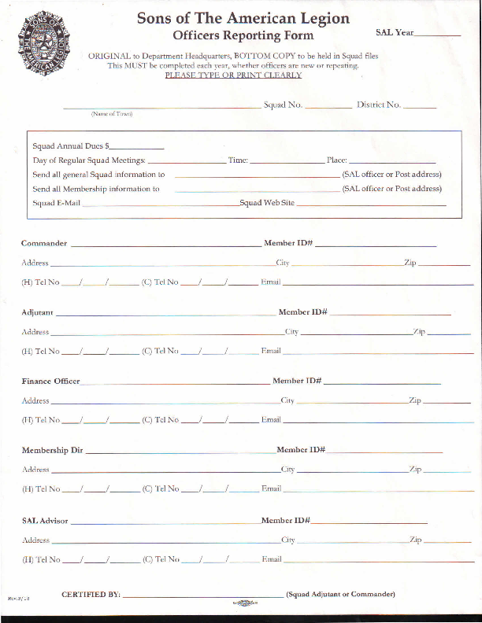
Squadron Officer Reporting Form
Why is it needed
Communication
We can’t get you information if we don’t know who to send it to!
If the District, Department or Detachment has questions, they need to know who to contact.

Slide 21
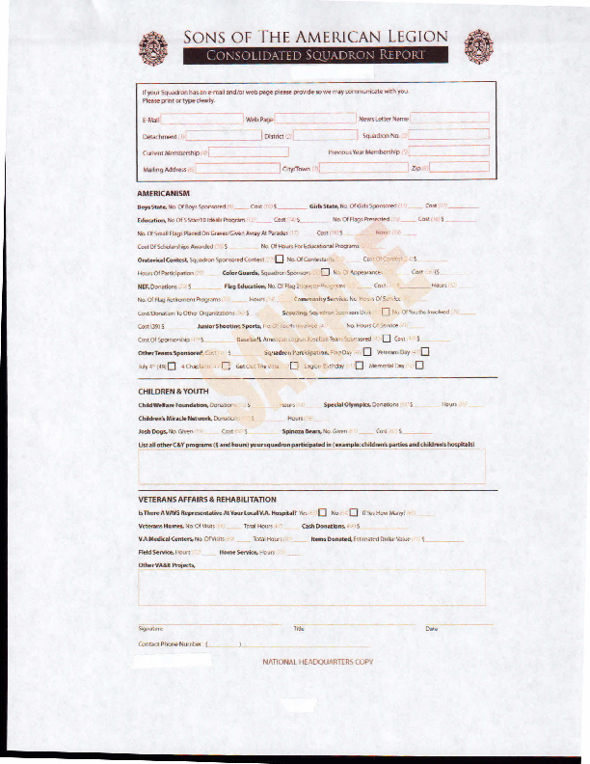
Consolidated Report Form
Submitting your Consolidated Report allows your membership to get credit for the good things your Squadron has done throughout the year.
Submitting your Consolidated Report helps explain to Congress why the Sons exist and why we need to continue to exist.
Reviewing the CR can give you ideas on other projects your squadron can complete.

Slide 22
Questions?
Detachment Resources
Bill Kuehner Membership Chairman
email: bkuehner@sbcglobal.net
Ray Hartline Vice Commander 1st Division
email: rayannhart@verizon.net
Juan Torres Vice Commander 2nd Division
email: jauntorres10@hotmail.com
Jackie Matthews Vice Commander 3rd Division
email: jamathewsusmc@yahoo.com
Johnathan Poe Vice Commander 4th Division
email: johnathan.poe@hotmail.com

Slide 23

Detachment of Texas

