Slide 1

Knowledge is POWER
Sons of the American Legion 2016-2017 Membership

Slide 2




When we last left our hero…
How do we increase membership?
SAL Meeting
Where do we find new members??

Slide 3

I have the answer…
We can
grow our membership by helping to grow The American Legion!
Sign up a Veteran and their son today!
“Be a super hero and sign up three American heroes today”

Slide 4

Armed with the Legion Family Application, the South has shown us a “super” way to recruit its new members

Slide 5
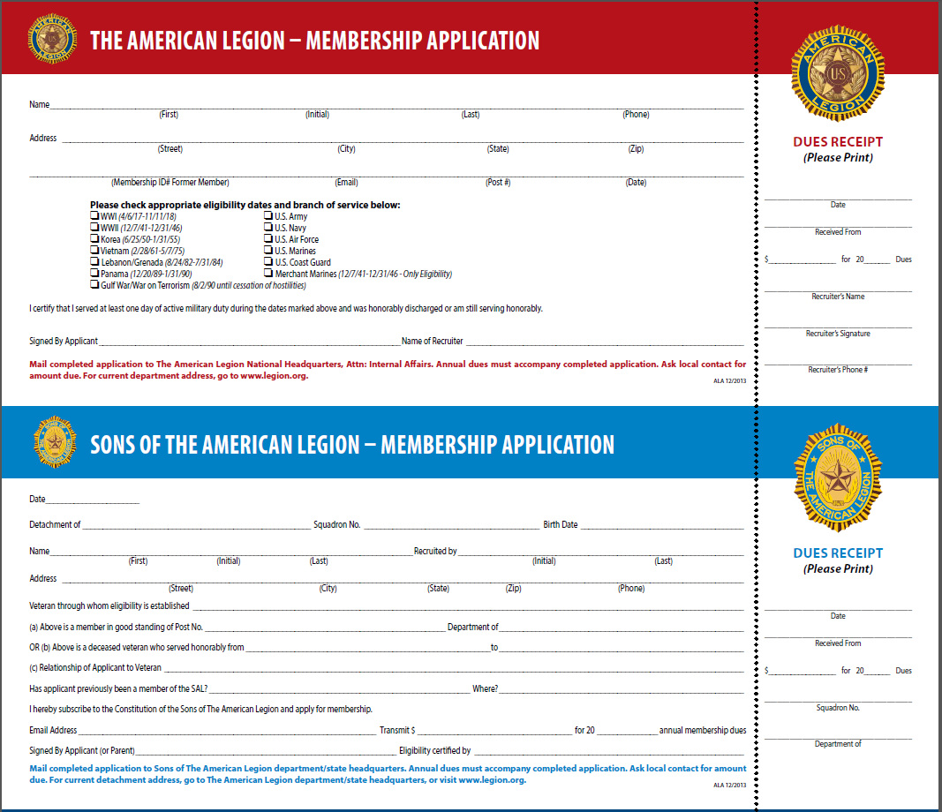
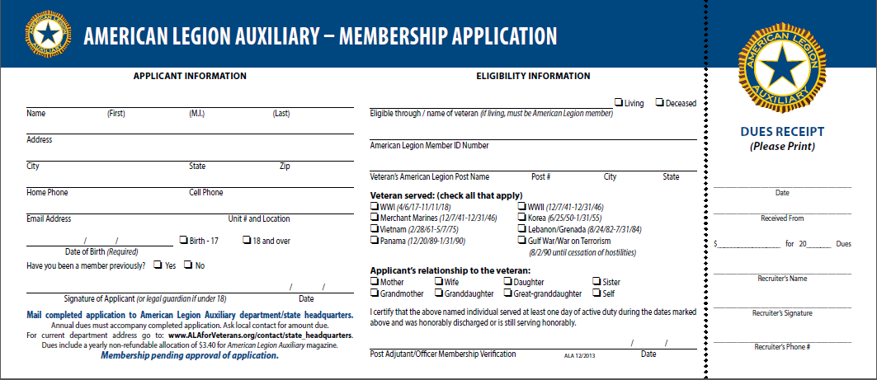
Legion Family Application

Slide 6


The Western Region reminds us that membership makes a “super” gift

Slide 7

The Mid-Western Region thinks that the changes to the 2018 membership card are “super”

Slide 8

The cards have been updated to collect:
    Phone Number
    Date of Birth
    Email
Collecting this information will allow for increased communication with our members.
Additionally, you will be able to update existing information for the first time!!!

Slide 9
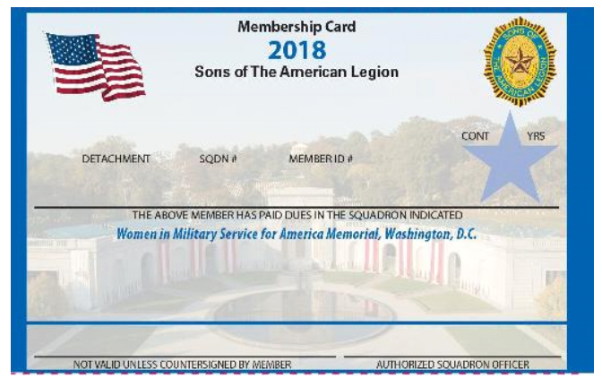
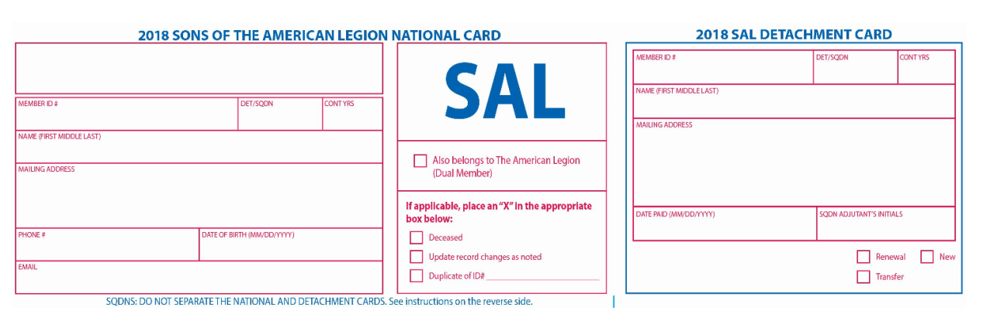
2018
Membership
Card

Slide 10
2016-2017 Membership Committee
CHAIRMAN- Seth A. Rippe (NE)
  305 19th St. NE., Cedar Rapids, IA 52402 (s_rippe@hotmail.com)
EAST- Robert Turner (CT)
  42 Blue Hill Road, Monroe, CT 06468-2017 (rturner586@aol.com)
SOUTH- Steve Gower Sr. (VA)
  4308 Bart St., Portsmouth, VA 23707 (stevegower@cox.net)
CENTRAL- Bruno Williamson (IL)
  405 East Belle Ave., Rantoul, IL 61866-1805 (nellazecca@mchsi.com)
MIDWEST- Charles Keith (WY)
  PO Box 433, Lander, WY 82520 (crkeith@hotmail.com)
WEST- Joseph E. Roberts (AZ)
  302 N Loquat Ave., Tucson, AZ 85710 (azmembership@yahoo.com)

