Slide 1
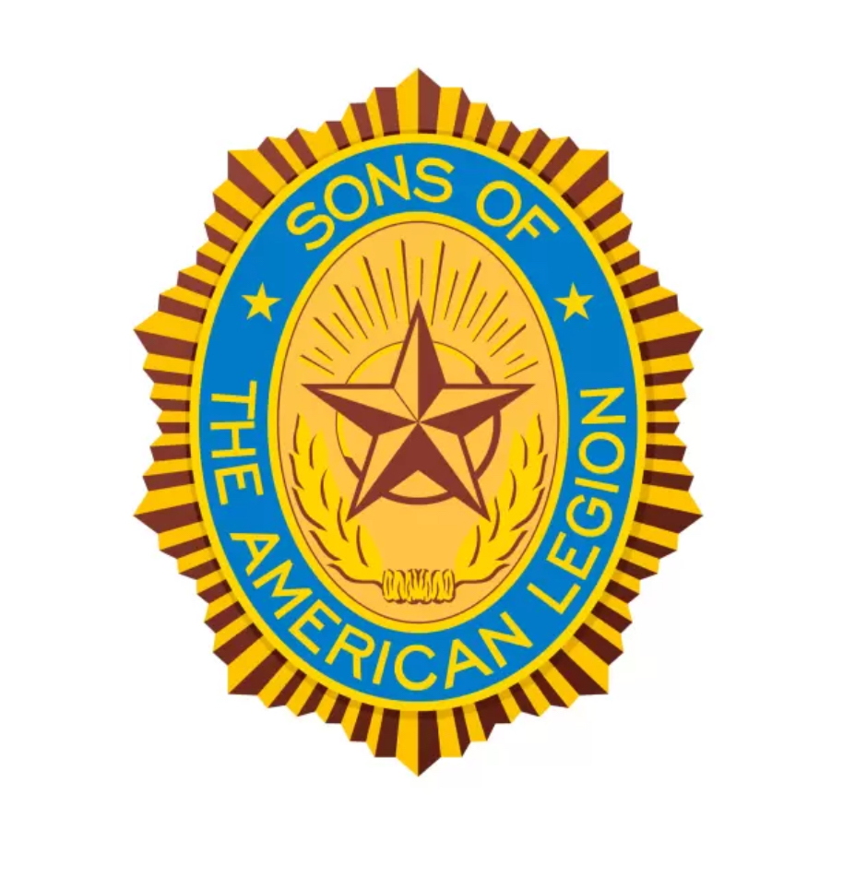
The Preamble to the
Sons of The American Legion
Constitution
George Alva - 2024

Slide 2
Proud possessors of a priceless heritage, we male descendants of veterans of all wars, associate ourselves together as “Sons of The American Legion” for the following purposes:
To uphold and defend the Constitution of The United States of America; to maintain law and order; to foster and perpetuate a true spirit of Americanism; to preserve the memories of our former members and the associations of our members and our forefathers in all wars; to inculcate a sense of individual obligation to the community, state and nation; to combat the autocracy of both the classes and the masses; to make right the master of might; to promote peace and good will on earth; to safeguard and transmit to posterity the principles of justice, freedom and democracy, to consecrate and sanctify our friendship by our devotion to mutual helpfulness; to adopt in letter and spirit all of the great principles for which The American Legion stands; and to assist in carrying on for God and Country.

Slide 3
At the beginning of every S.A.L. meeting, we stand up to honor our country’s flag with the Pledge of Allegiance and a salute. We bow our heads in prayer, honor the POWs and MIAs, and we recite the Preamble to the Constitution of the Sons of The American Legion. A preamble is the introductory part of a constitution or statute that usually states the reasons for and intent of the law.
We recite the Preamble in unison. Many of us have for years, but do we understand the meaning behind every word or phrase in the Preamble? The Preamble was written almost 100 years ago by men who lived in world and time that seem so different from ours. Time has moved on, and the world is different now, but the guiding principles of the Preamble have remained steadfast and remain true today.
The goal of this presentation is to explain in simple terms what we are pledging ourselves to, in such a way that young people can understand and appreciate and therefore carry on the mission and legacy of the S.A.L.

Slide 4
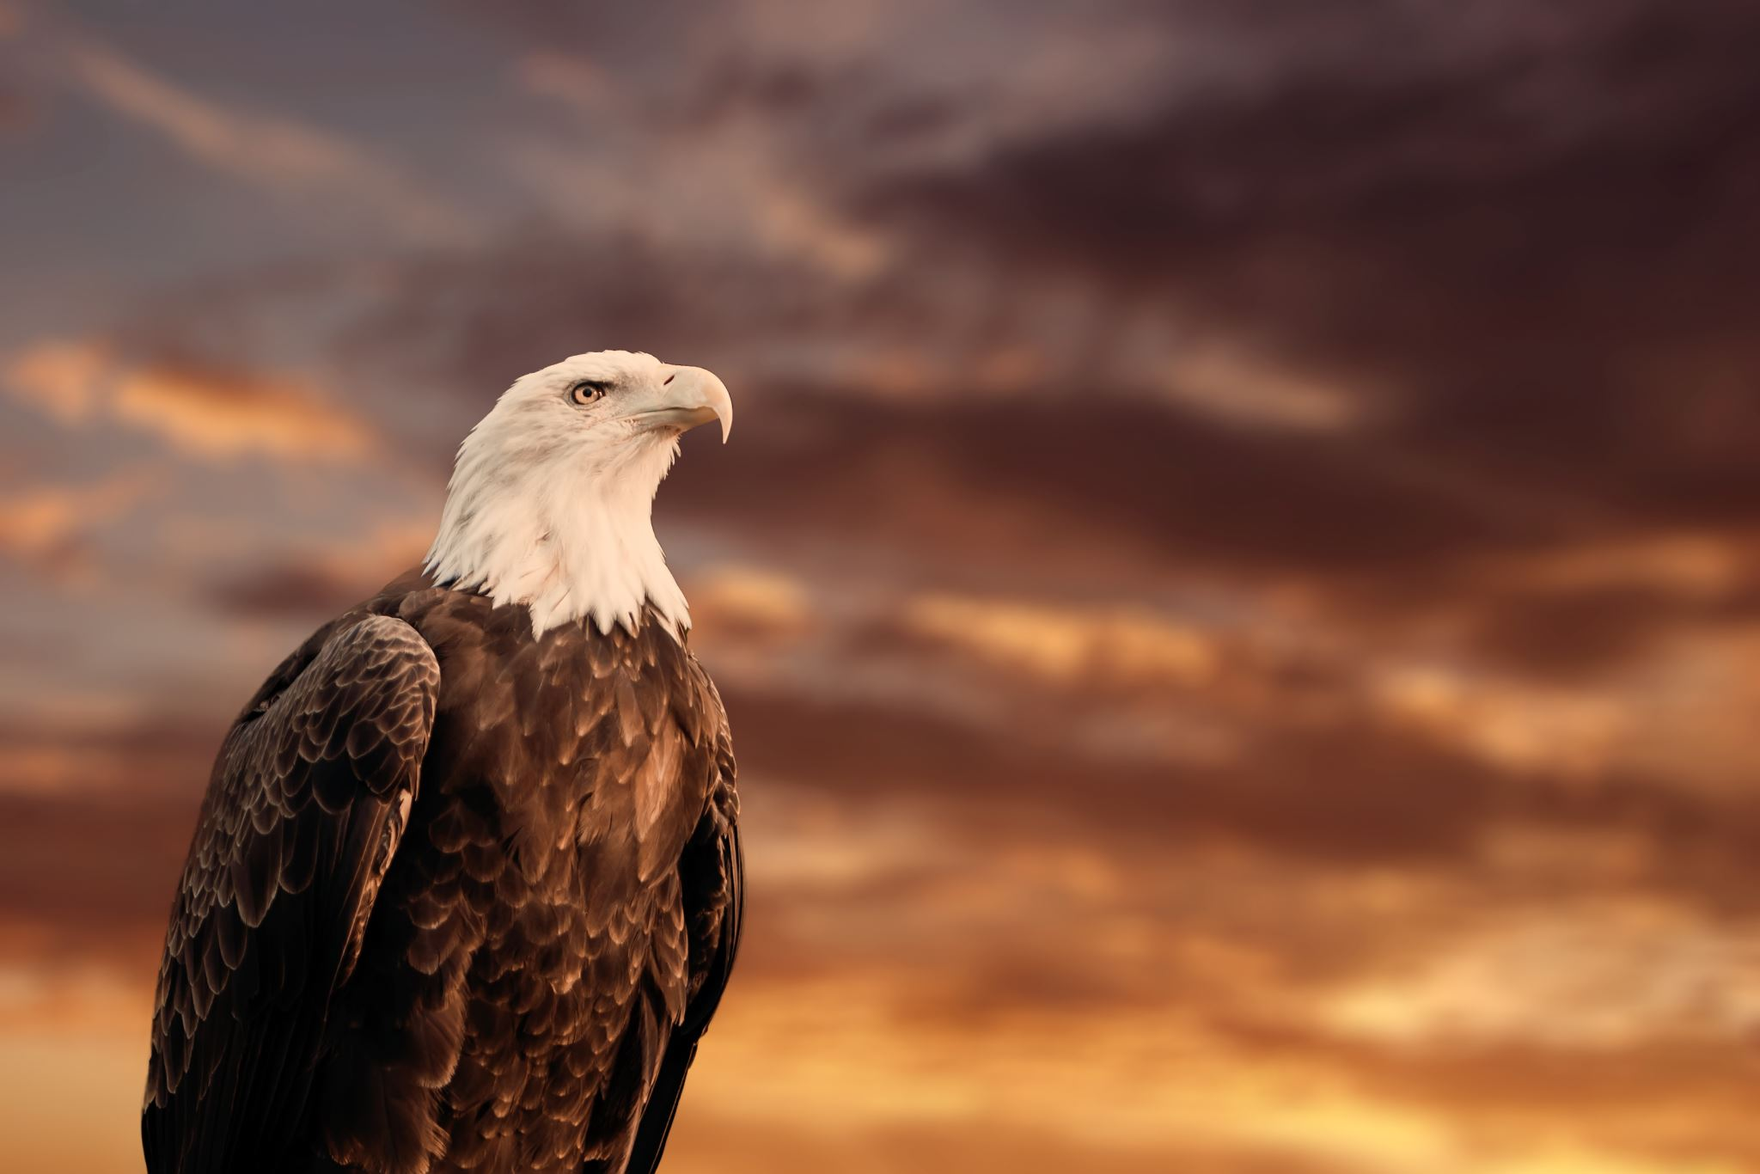
Proud possessors of a priceless heritage…
Heritage refers to practices or characteristics that are passed down through the years, from one generation to the next. As S.A.L. members, we take pride in the fact that we have assumed stewardship of a legacy created by our parents and grandparents who served in our nation’s military forces. Today is our time. It is our responsibility to honor the trust bestowed upon us to carry on the traditions, ceremonies, memories, and mission of the S.A.L.
Now is the time to for us to teach our descendants about the S.A.L. and instill in their hearts the priceless heritage they will inherit. Let’s leave them an organization they will be proud to be part of.

Slide 5
We male descendants of veterans of all wars…
Throughout its history the United States has been involved in many wars around the globe. To name just a few: The American Revolution, Barbary Wars, War of 1812, Mexican-American War, U.S. Civil War, Spanish-American War, World War I, World War II, Korean War, Vietnam War, Grenada, Persian Gulf War, Afghanistan, Iraq, Desert Shield, Desert Storm, and the Global War on Terror.
War is ugly. War is horrible. War is hell. Yet, every American involved in these wars raised their right hand and swore an oath. They went in knowing there was a very good chance they would not return. The soil of this earth is soaked in the blood of those who sacrificed their lives to preserve democracy and the freedom we enjoy in America.
We male descendants of veterans of all wars are the sons and grandsons of genuine heroes.

Slide 6
Associate ourselves together as “Sons of The American Legion” for the following purposes…
“Together” is a powerful word. It means you and me. It means us. It means we. One drop of water is not a flood. One flake of snow is not an avalanche. One strand of string is not a rope. But bring each one of these things together with many others of its kind and you’ll get a flood, an avalanche, and an unbreakable rope. The following quotes eloquently describe what together means.
“We must learn to live together as brothers or perish together as fools.” – Martin Luther King, Jr.
“United we stand, divided we fall.” – Founding Father John Dickinson.
“We must, indeed, all hang together or, most assuredly, we shall all hang separately.” – Benjamin Franklin.
Humans are social animals, therefore we come together to participate in many different activities. One reason we joined the S.A.L. is so that we could spend time with like-minded individuals and enjoy the camaraderie. However, we must not ever forget that the purpose of our membership is to honor our parents’ and grandparents’ service by helping veterans, children and youth, those in need, and assisting The American Legion in carrying out its mission. It matters not whether you do a little or a lot if you are doing something other than occupying the space underneath your blue garrison cap. Be a participant, not just a number. Fulfill the purpose!

Slide 7
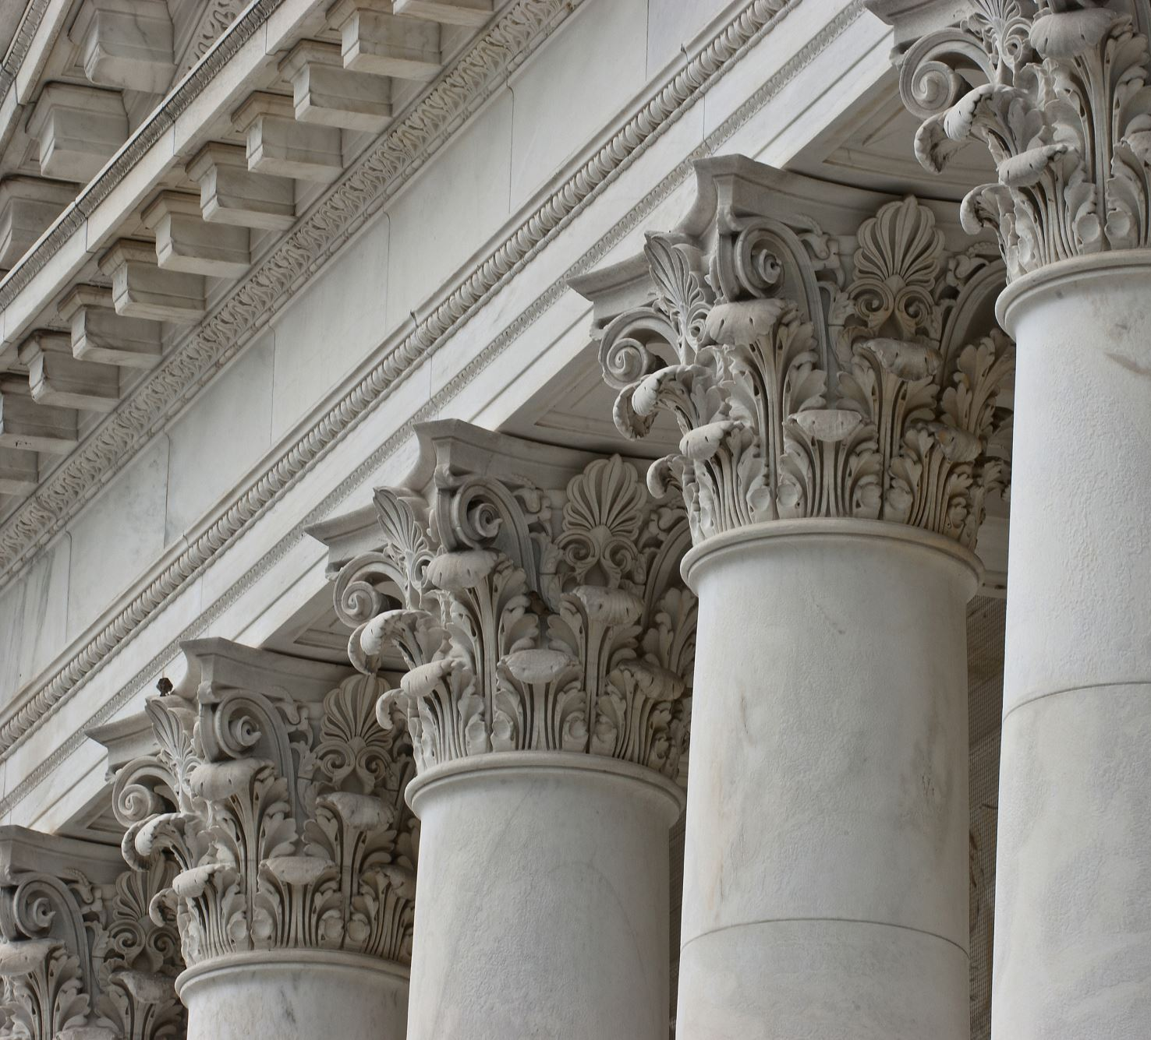
To uphold and defend the Constitution of the United States of America;
The United States Constitution was officially ratified in 1788 by nine of the original Thirteen Colonies. This significant moment occurred ten months after delegates finalized the document at the Constitutional Convention of 1787. Upon its ratification the Constitution became the supreme law of the land and remains our country’s most sacred document.
The Constitution, which includes a preamble and seven articles that express the essential ideas of the federal government, specifies the national framework of government. It creates three branches of government: the legislative, the executive, and the judicial branches. It also describes each branch’s powers, as well as American people’s rights and liberties. Yours and mine!
The Constitution is the oldest and shortest constitution of any major government on earth and is often used as a model for the constitutions of other countries. It has been amended 27 times and includes the Bill of Rights which are the first ten amendments that were adopted as a single unit in 1791.
Each time we recite the Preamble we repledge our commitment to preserve, protect, and defend the U.S. Constitution against all enemies foreign and domestic. If the threat is external from a foreign aggressor, our first line of defense is our military. If the threat is internal, we have the power to protect it through the ballot box. We must always remain vigilant.

Slide 8
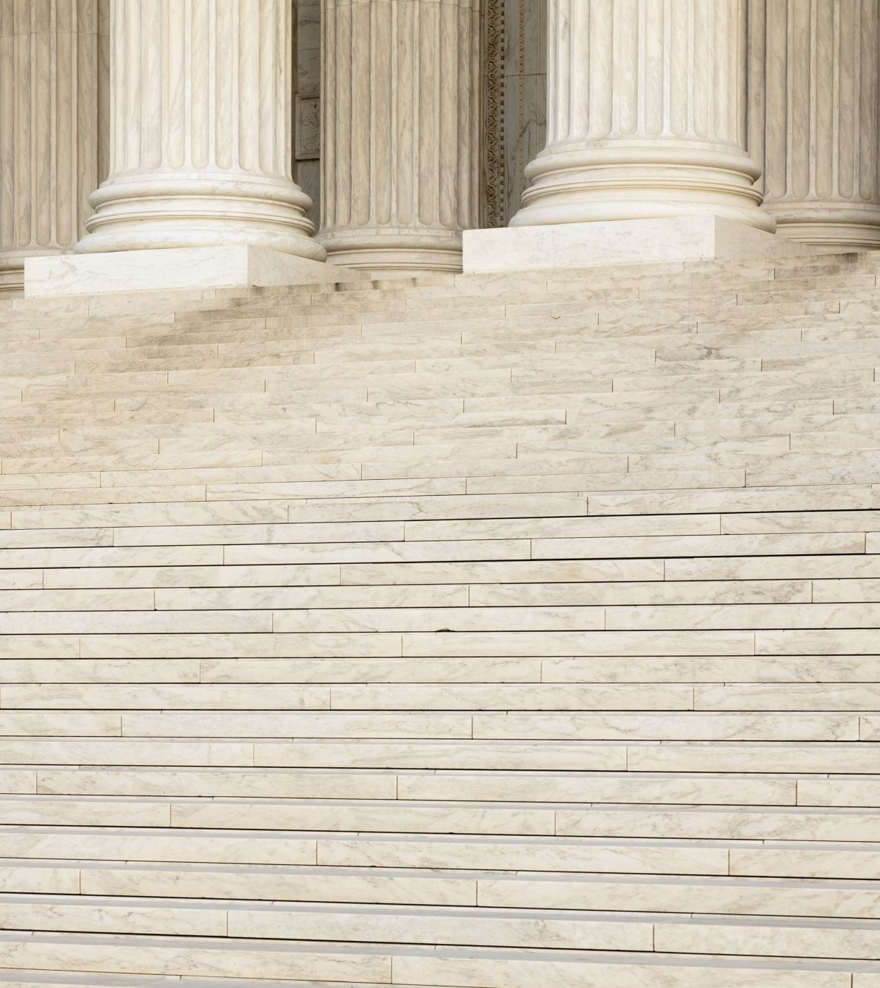
Maintain law and order;
This is an easy one. As citizens we do our part by being aware of and respecting the laws of our city, state, nation, and any foreign country we visit. We teach our children respect for the Law, and we do our part to support the men and women tasked with enforcing the laws of our land. We support our troops sent to other countries to maintain law and order where none exists. We stay alert and keep our eyes and ears open. We stand up to injustice when we see it. Someone once said the only thing nec­es­sary for the tri­umph of evil is for good men to do noth­ing. We won’t stand around and do nothing.

Slide 9
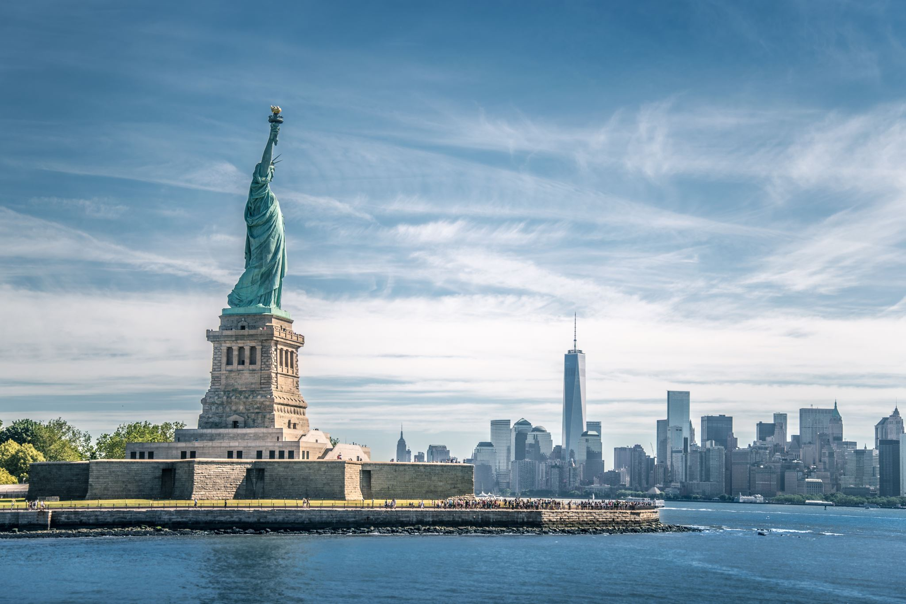
To foster and perpetuate a true spirit of Americanism;
Americanism is one of the four pillars of The American Legion. The other three are Veterans Affairs & Rehabilitation, National Security, and Children & Youth.
Americanism is the love of America. Patriotism! It is loyalty to America’s institutions as the best yet devised by man to secure life, liberty, individual dignity, and happiness. It is the willingness to defend our country and flag against all enemies. Americanism is a vital, active, living force.
We do our part to keep it going with flag ceremonies, parades, programs such as Boys State, Oratorical, Baseball, Scouting, mentorship, and camaraderie.

Slide 10
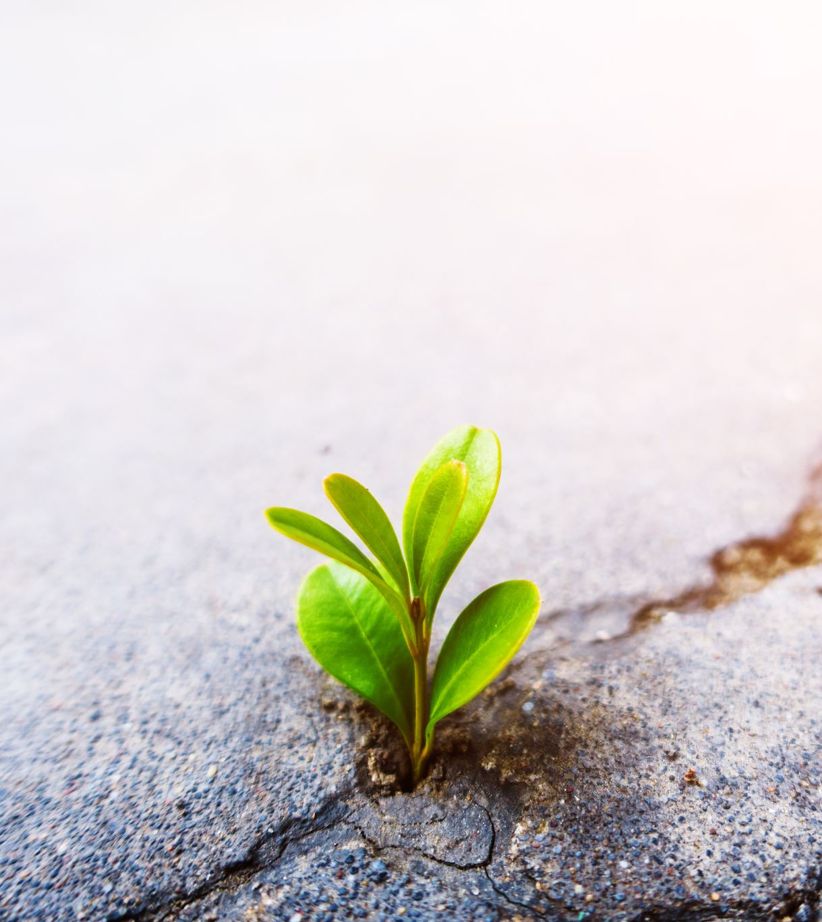
To preserve the memories of our former members and the associations of our members and forefathers in all wars;
The preservation of memories is the preservation of history. We erect statues, build museums, and consecrate the gardens of stone where our veterans lie in eternal rest. We learn from the successes and failures of our predecessors. We honor the hard work and sacrifices of our ancestors by carrying on their legacy and improving on their successes. We preserve the memories of our former members and forefathers by writing their stories or naming a structure or event in their honor. On Veterans day we honor those still with us and honor on Memorial Day those who have passed.

Slide 11
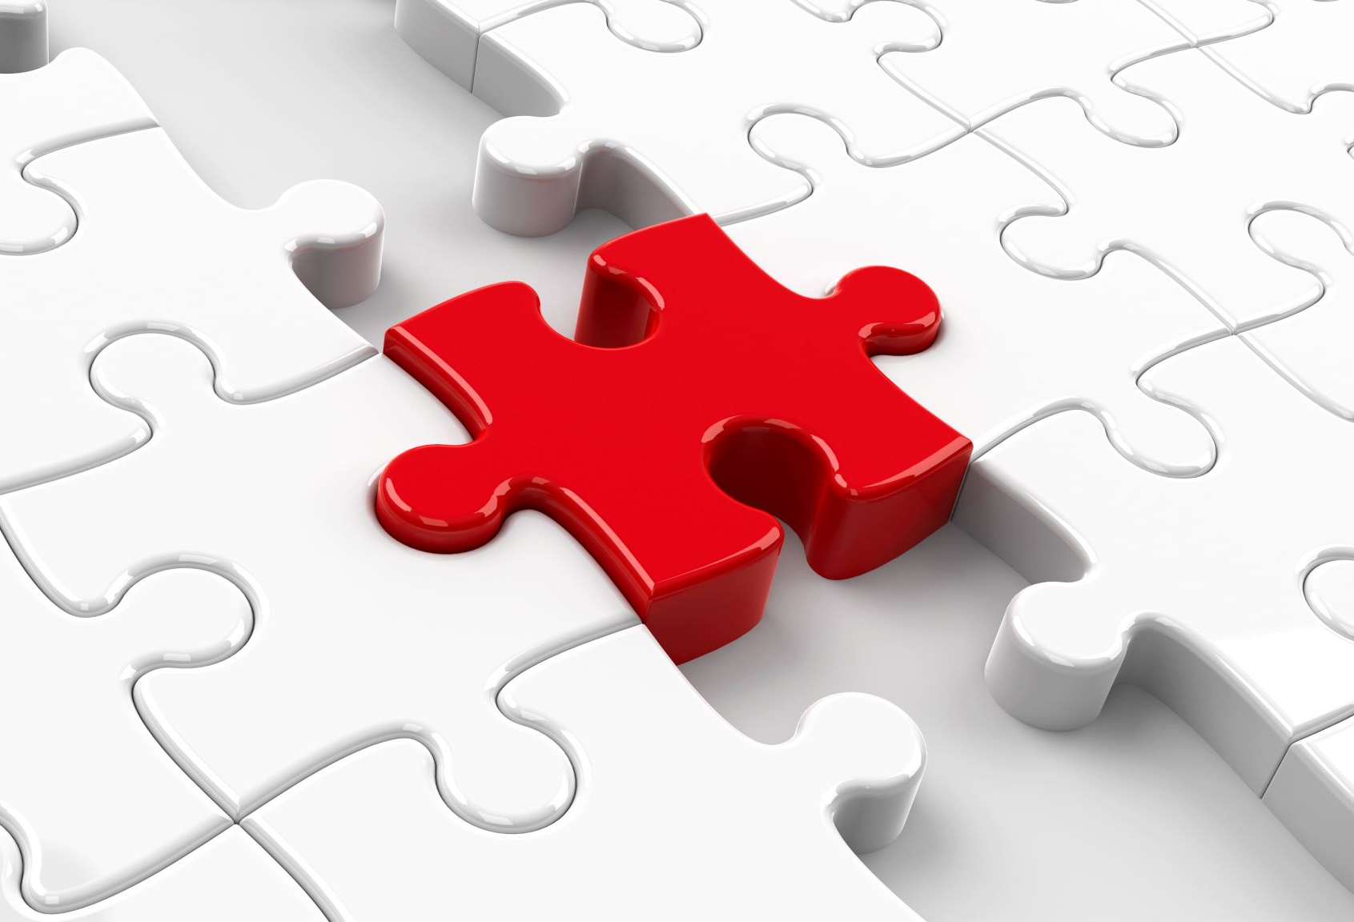
To inculcate a sense of individual obligation to the community, state, and nation;
Inculcate is not a common usage word. It means to instill an attitude, idea, or habit by persistent instruction. It is our responsibility through repetition, but especially through example, to teach the virtues of good citizenship. As citizens of our community, it is our duty and obligation to be neighborly, helpful, and watchful, and to work diligently to make our state and nation a safe place where all can live, work, and play together in peace. We must also be prepared to defend our country when called upon to do so.

Slide 12
To combat the autocracy of both the classes and the masses;
America is a diverse nation, composed of people from different backgrounds, ethnicities, and economic strata. In this democratic framework, both the privileged classes (those with economic or social advantages) and the masses (the general population) have a role to play. As Legion family members we stand as guardians of democracy. By opposing autocracy, we stand on the side of righteousness. It is our aim to ensure that neither the elite nor the majority suppress individual rights or undermine democratic principles.

Slide 13
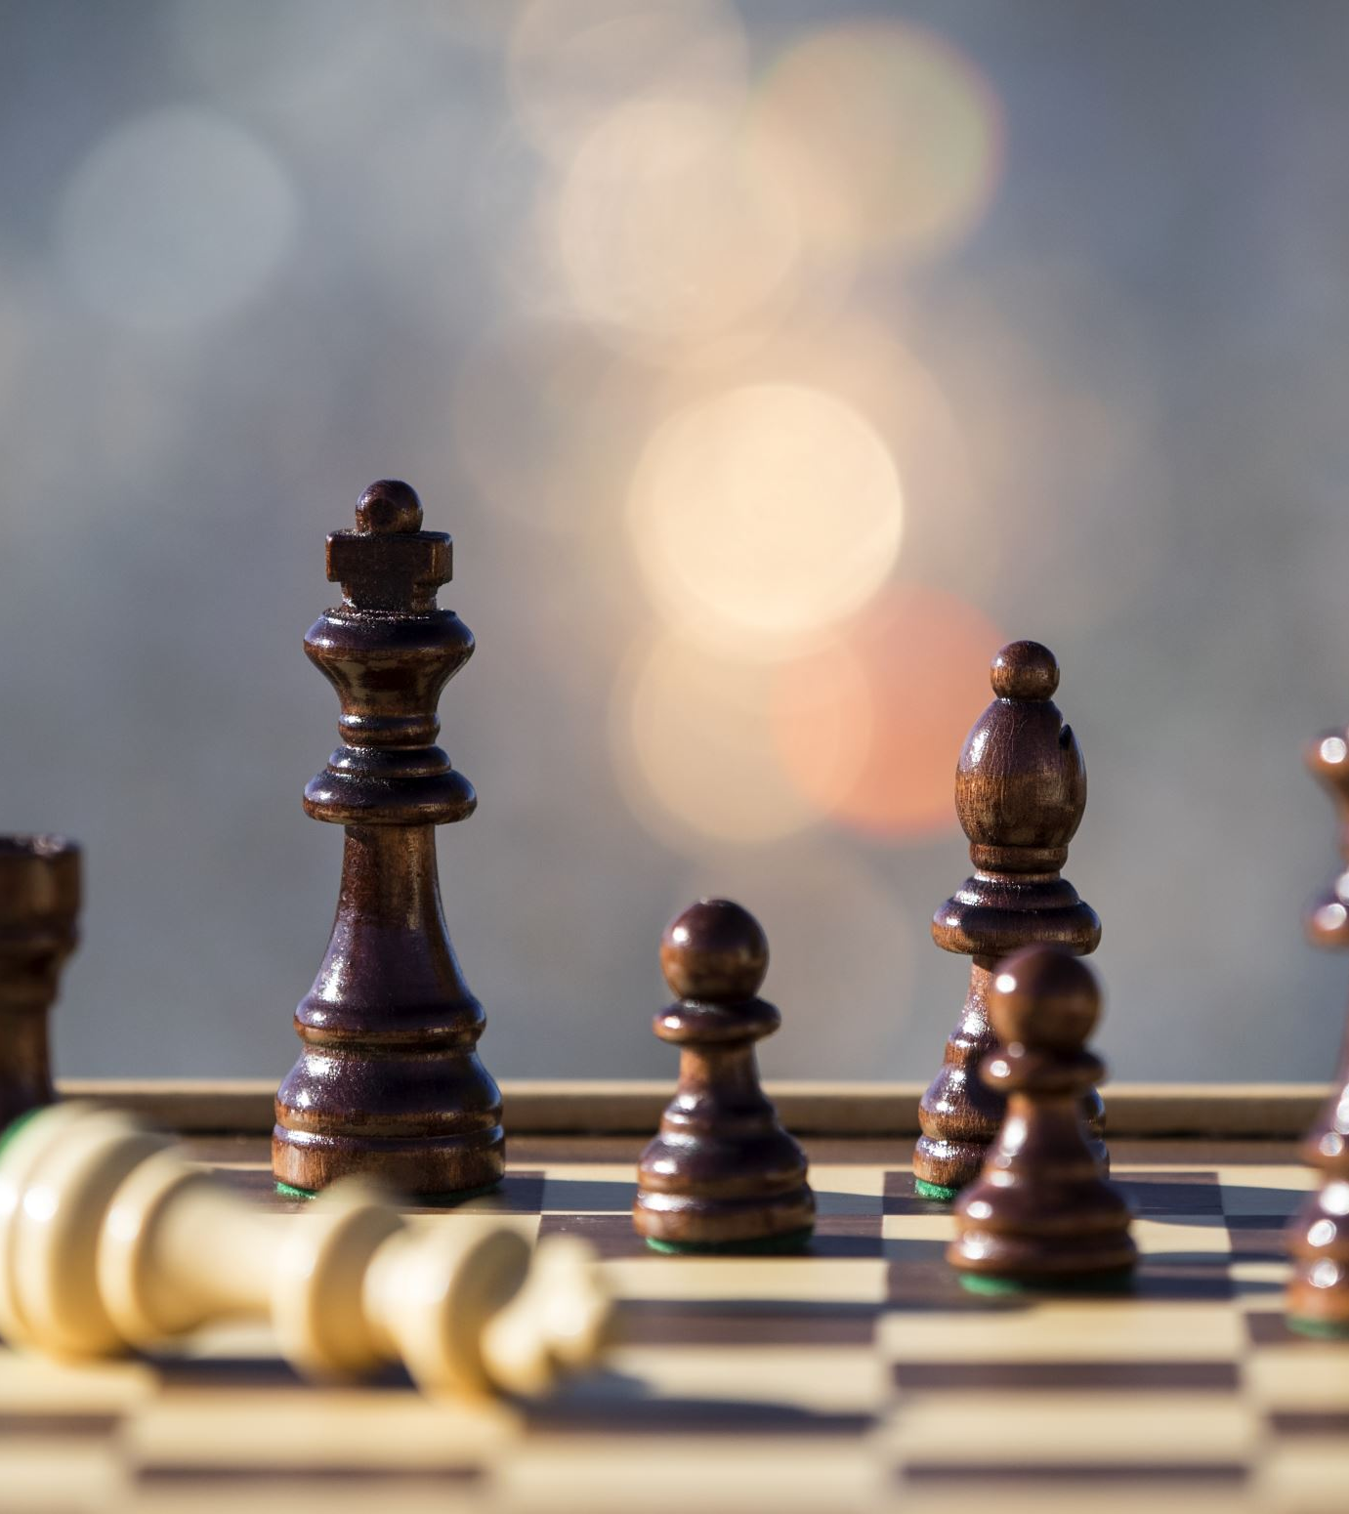
To make right the master of might;
Our organization’s commitment is to make sure that might does not overpower right. We seek to maintain a balance where justice, freedom, and democracy prevail.

Slide 14
To promote peace and goodwill on earth;
True peace between nations is a lofty and maybe unattainable goal. The last two humans on earth will find something to fight about. For now, we do our part through diplomacy, education, communication, charity, assistance, example, and treating with respect everyone we encounter. When we take the first step towards peace and goodwill, we create a ripple effect. It’s the Golden Rule: Treat others as you wish to be treated.

Slide 15
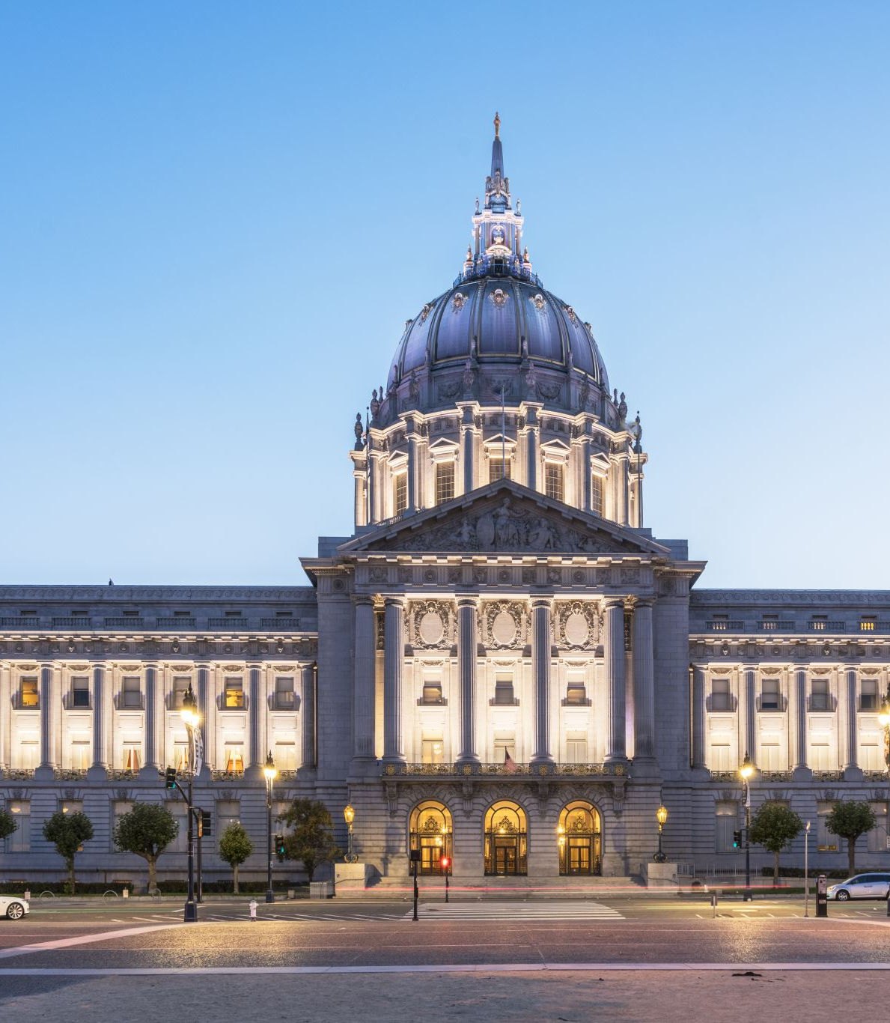
To safeguard and transmit to posterity the principles of justice, freedom and democracy,
The Legion family actively works to preserve and transmit these principles to future generations, ensuring that justice, freedom, and democracy remain at the core of American society. This is done in a variety of ways such as advocacy and legislation, veterans support, community service, education and awareness, patriotic activities, and youth programs such as Boys State and Girls State. These initiatives empower young people to learn about democratic processes, leadership, and civic engagement.

Slide 16
To consecrate and sanctify our friendship by our devotion to mutual helpfulness;
When World War I, the war to end all wars ended, soldiers who returned relatively unscathed without wounds or what was known back then as shellshock, got together to form an organization whose aim was to aid and support the wounded and those afflicted emotionally and psychologically by the horror of war. The Legion was created to fight for and secure veterans’ rights. We stand on the front line of that fight!
Not only are we here to help each other, we are here to help the men and women who put their life on the line for us. We are here to help others because we can. This is why we joined. This is why we stand and recite the Preamble before every meeting.

Slide 17
To adopt in letter and spirit all of the great principles for which The American Legion stands;
The S.A.L. is a program of The American Legion. Each time we recite the Preamble we reaffirm that we will do our part to maintain the mission of the Legion. We pledge that we will devote our time to mutual helpfulness, friendship, law and order, Americanism, Veterans Affairs & Rehabilitation, National Security, and Children & Youth.
A priceless heritage was passed to us. It was paid for with hard work, sacrifice, sweat, tears, and blood. We must always guard it so that we can pass it to the next generation of members of the Sons of The American Legion. It is our duty and our obligation.

Slide 18
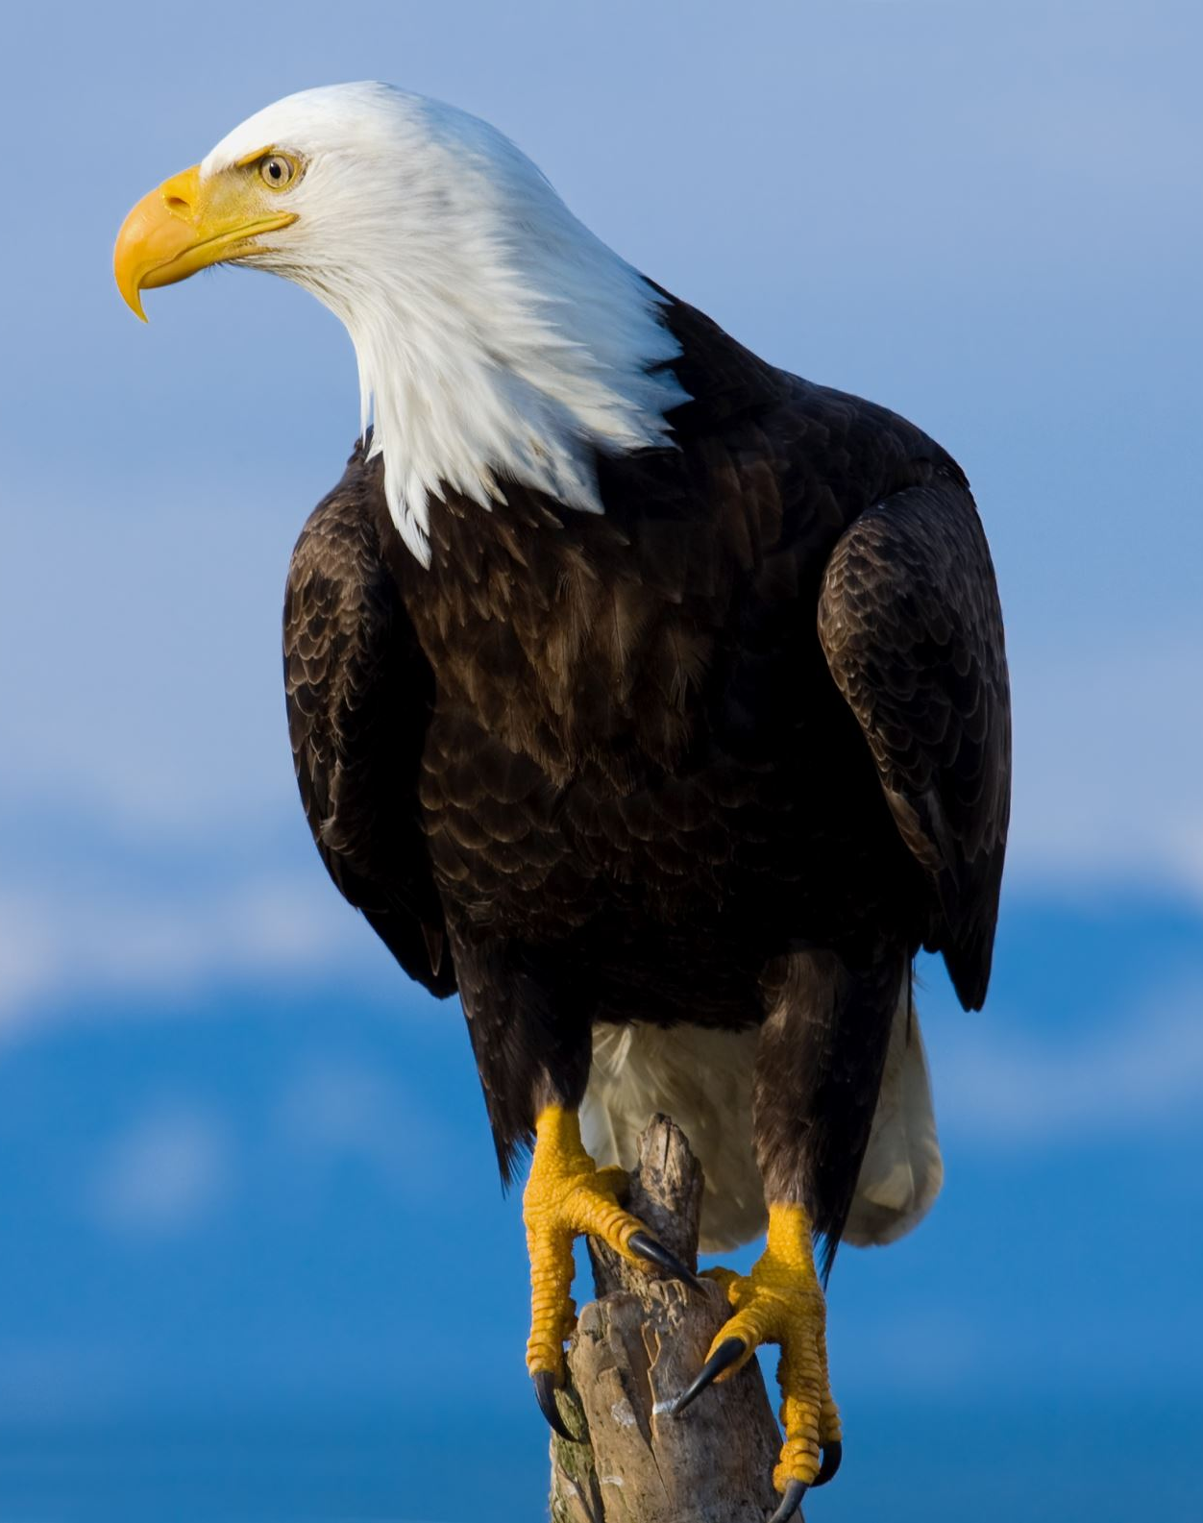
And to assist in carrying on for God and Country.
Life is God’s gift to you. What you do with your life is your gift to God. When you assist a child or an adult in need you are carrying on for God. When you assist a veteran, you are carrying on for our country; the United States of America.

